Slide 1
JetHexa with MediaPipe

Slide 2
What is MediaPipe
MediaPipe is a library of pre-trained Machine Learning Neural Networks made by Google that can be loaded in and used
The models are fast and can be run on a range of lower and higher end devices, without the need to train the model yourself
Their pre-trained models can do things like:
Object Detection
Gesture Recognition
Text Classification
Audio Classification
Face Detection
And much more

Slide 3
JetHexa with MediaPipe
The model we are going to use today is their Face Detection model
As said before, the library just needs to be included in the Python file to be used
The MediaPipe library takes care of the Face Detection, processing, and drawing the bounding box around the face

Slide 4
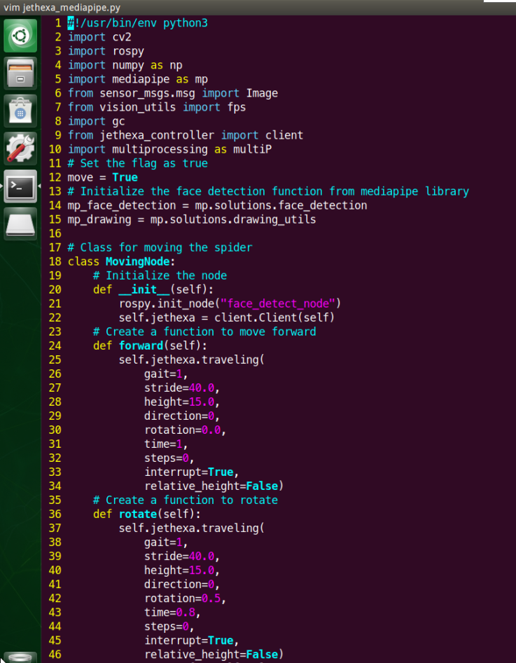
Code
The rest of the code is the same as the Haar Cascade, just the main function is different
Line 62 is where the Face Detection model is loaded in
“mp” stands for MediaPipe

Slide 5
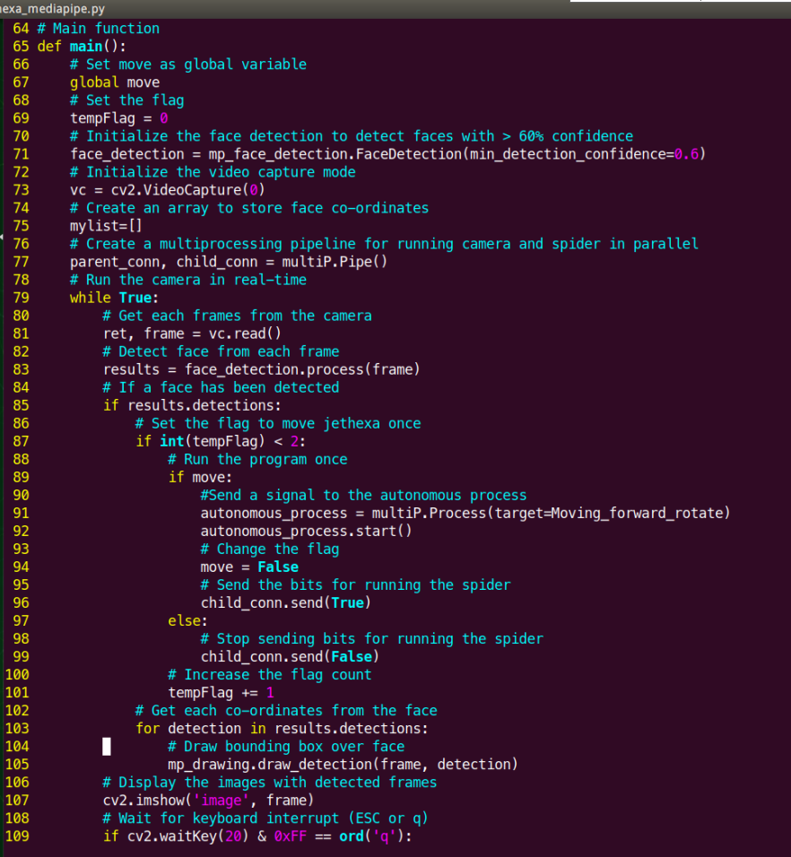
Code
The same as with the Haar Cascade Classifier code, it is setup to run the action only once
If you wish to change this, ask your TA for help changing line 94 from “move = False” to “move = True”

Slide 6
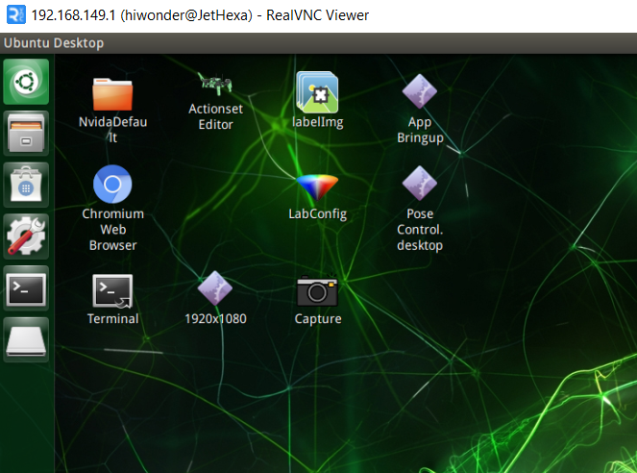
Code Execution
Open the terminal

Slide 7
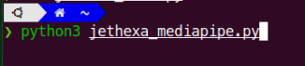
Code Execution
To run the code, execute the following command
“python3 jethexa_mediapipe.py”

Slide 8
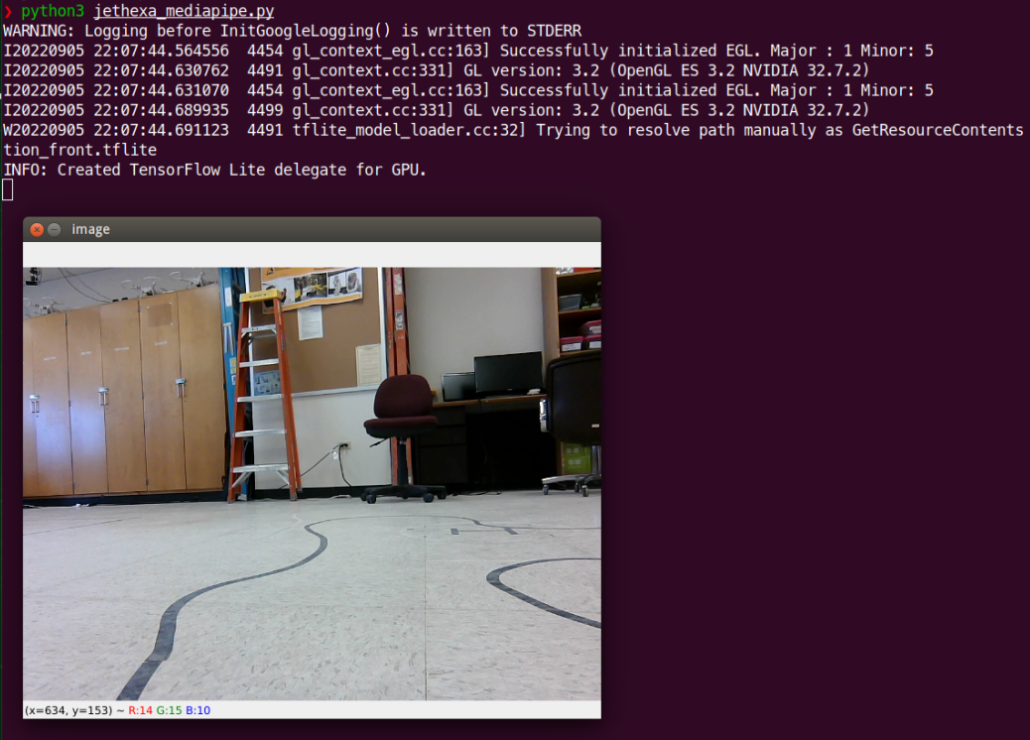
Code Execution
After initialization, a camera window like the one below should appear

Slide 9
Code Execution
Test out the model
Does the model perform better (detect more faces) than the Haar Cascade Classifier?

Slide 10
Next Up
Face Detection with PyTorch

